Slide 1
1
Retail Sales Data – Price Trends
Presentedby : -
Manish Rajak Mohamed Athif

Slide 2
1. Introduction 2
In this presentation, we will showcase key insights and visualizations derived from a Retail Sales dataset, using Pandas for data manipulation and Seaborn/Matplotlib for exploratory data analysis and effective data visualization.

Slide 3
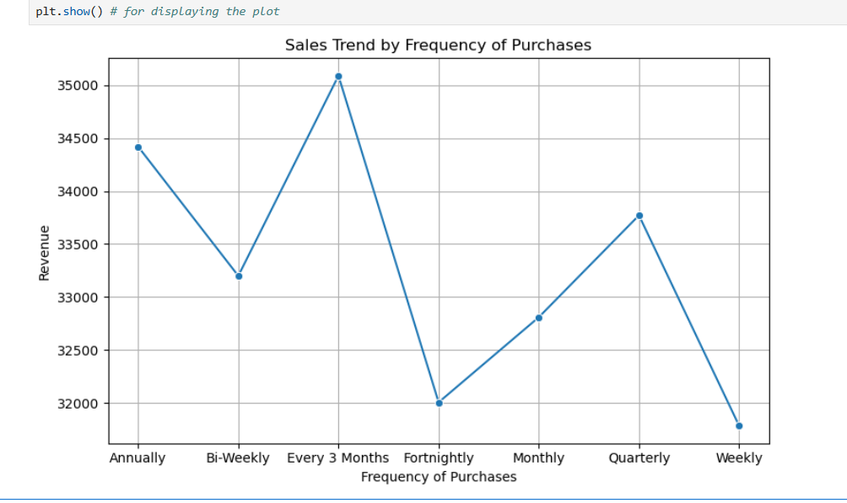
Key Insight:
1. High Revenue From Repeat Buyers means If revenue increases with higher frequency, it shows that customer that believe more in that company contribute more. This insight supports customer retention strategies. And Company can take good step for this type of customers. Customer who purchase every 3 month contribute the most revenue.
2. Lower revenue: Weekly and fornightly customers generate less revenue. They can be first time buyers or not more interested to buy frequently. if they are first time buyers then company should give a good offer as possible.
3. Annually, Quarterly, and Bi-weekly buyers all show high revenue indicating strong loyalty or higher spending.¶

Slide 4
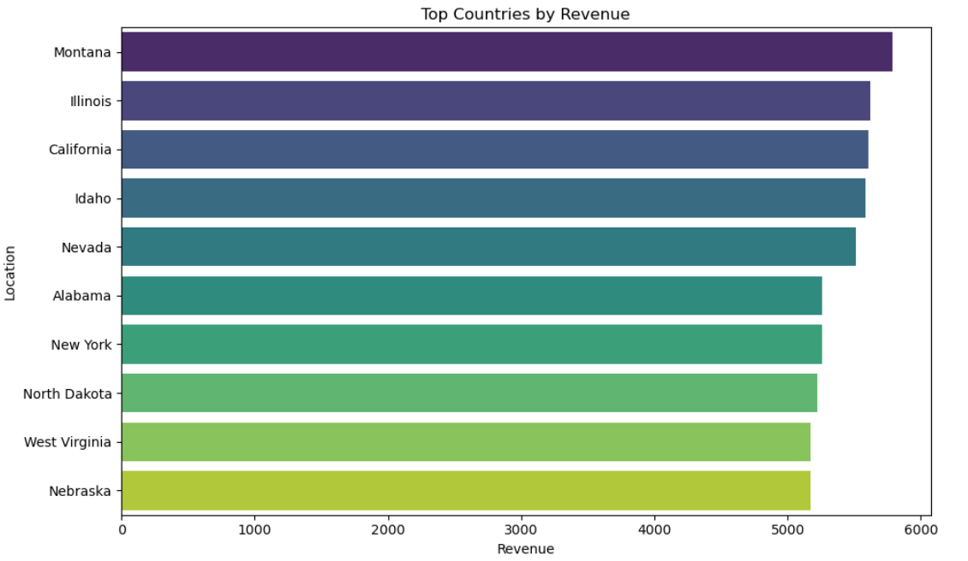
Key Insights:
1. Top revenue Generating Countries: In this bar char we can see that which country contribute to generate more revenue and we can also see others
2. We can more focus on that country that is generating more revenue so that company can earn more.
3. If expected large economies like USA, UK, Japan etc are missing from the top 10 location it means issues in market reach higher chances.¶

Slide 5
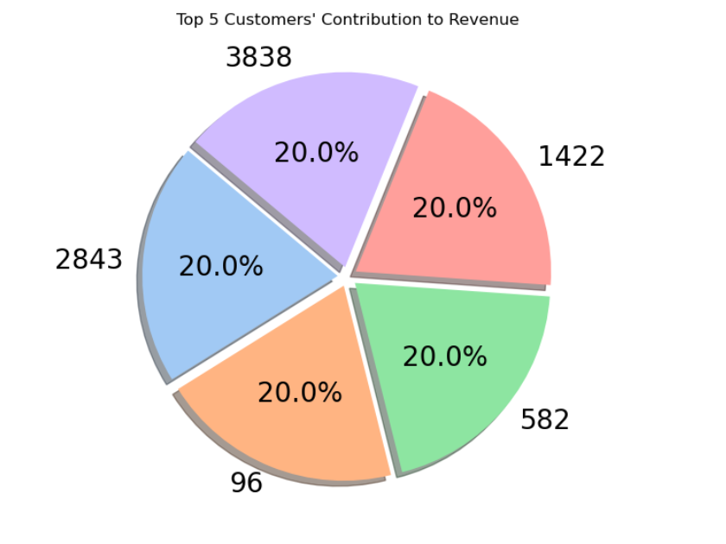
Key Insights:
1. In this All 5 Customers contriubute about equally in revenue. this show revenue comes from many customers, not just a few big spenders.
2. Each Customer has only one transaction, so we can say that top spenders are not loyal. top spenders bought expensive products.
3. Company should focus on attracting many customers, not just big spenders. promote high value items with good price so that company will boost their revenue.

Slide 6
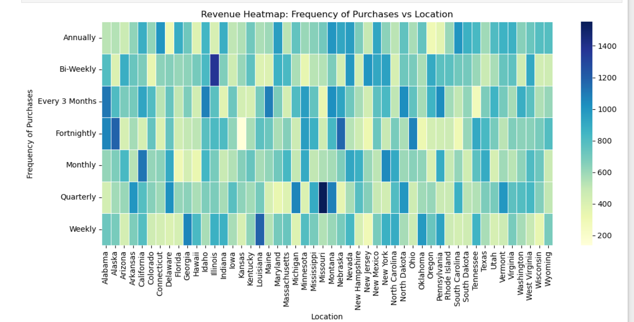
Key Insights:
1. Revenue Distribution: The heatmap shows revenue varies by purchase frequently and location. Some locations repeated more times means this types of location are contribution more in generation revenue.
2. Locations with ‘Weekly' or 'Fortnightly' showing higher revenue. that means these are active markets.
3. States with 'Annually' or 'Quarterly' showing lower revenue. that means company should more focus on these locations.¶

Slide 7
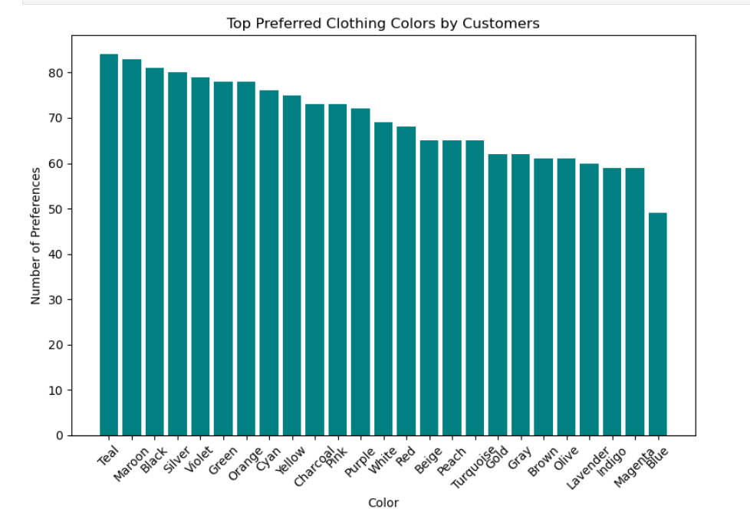
Key Insights:
1. Popular Colors: Teal, Maroon, and black are top clothing colors.
2. Customers select a wide variety of colors that means no single color dominates.
3. Stocking high-demand colors like teal, maroon, and black can boost sales.

Slide 8
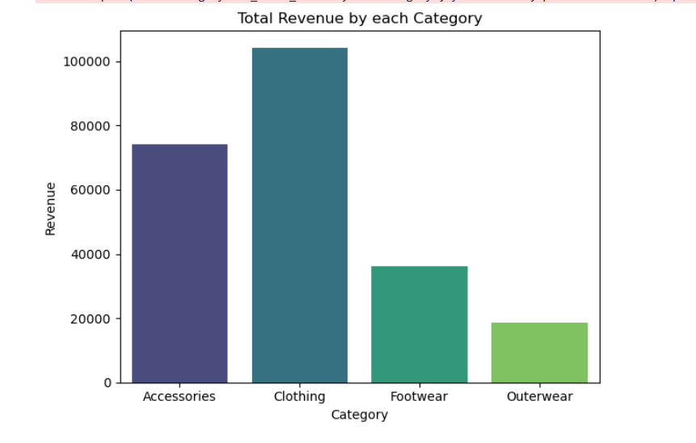
8
Key Insights:
1. Clothing Category is generating highest revenue. after that accessories category is generating higher revenue. So company should more focust on this type of category.
2. footwear is generating lowest revenue.¶

Slide 9
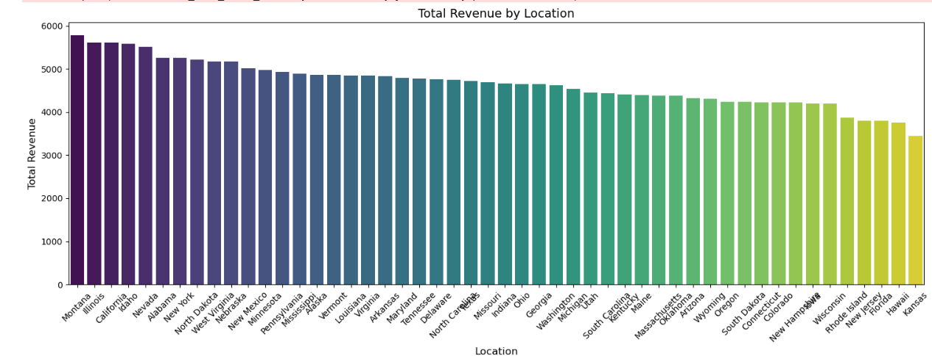
Key Insights:
1. In this We can Which location is generating more revenue and which location is generating low revenue.
2. Montana, illinois, and california is generation more revenue. that means these are active and strong market.
[81]:

Slide 10
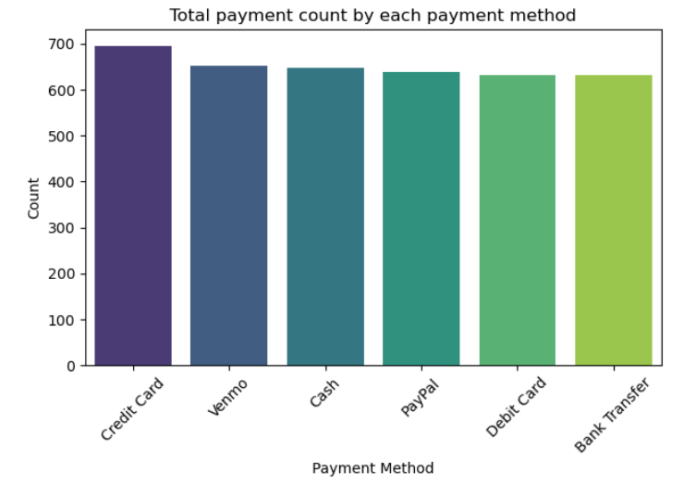
Key Insights:
1. Popular Payment Methods: Credi Card is most popular payment method. suggesting this is more preferred by the customers.
2. Less Common Methods: Cash and Bank transfer have lower usage, suggesting they are less preferred by the customers.
3. Company should prioritize supporting credit card so that company can earn more and generate more revenue.

Slide 11
Conclusion
This analysis of the Retail Sales dataset has revealed valuable insights into customer behavior, revenue trends, product preferences, and market performance. By leveraging Pandas and data visualization tools like Seaborn and Matplotlib, we identified high-performing segments, popular products and payment methods, and strategic opportunities for growth. These findings can guide data-driven decisions to improve customer retention, target high-revenue markets, and optimize product offerings.

Slide 12
Thank You!!!!

